Slide 1
Jimmy Budnik
VP Customer Care
JBudnik@overstock.com
Jimmy Budnik

Slide 2
Overstock Customer Care
Customer Engagement through Technology

Slide 3
Brand Vision
Dream homes for all
Brand Positioning
Making beautiful & comfortable homes accessible by helping customers easily & confidently find just what they want for less

Slide 4
Agenda
2020 Transformation
Technology Philosophy
Evolving Tech Platform
Success of Messaging
Continuing the Journey

Slide 5
2020 Transformation
Moved to work from home globally
American’s sheltered in their homes
Overstock experienced tremendous growth
Invested and focused on technology to adapt

Slide 6
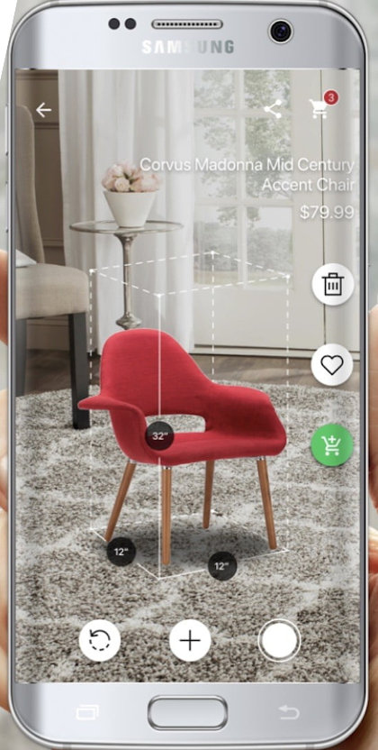
Customer Care Technology
We use technology to make the lives of our customers easier.

Slide 7
Our Traditional Platform

Slide 8
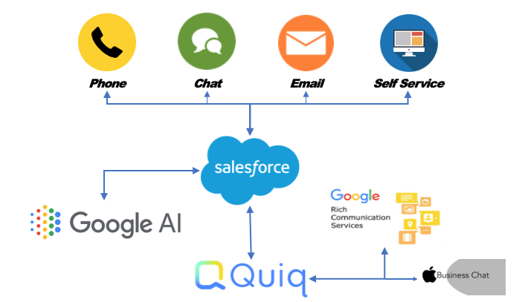
Our Evolving Tech Platform

Slide 9
Success of
Messaging
1.
3.
Order status messages
Customer content sharing tool
2.
4.
Mobile customer contact channel
Proactive mass communication

Slide 10
Customer-centric Communication
Preventative Communication
Use digital touchpoints to communicate realistic expectations.
When using technology to communicate, especially when automated, we aimed for these three P’s.
Proactive Communication
Use messaging to inform customers of delays or issues with their orders.
Personalized Communication
Connect customer data with their specific order data to offer a meaningful response

Slide 11
Where are we looking to evolve?
Google RBM and ABC
Create a channel of preference
Incorporate additional personalized, rich content
Wins on cost and delivers customer satisfaction
Master managing the conversation
Human-bot partnership
Understand the expectations of the asynchronous customer
Play to the strengths of technology and humans

Slide 12
Innovation Advice
1.
2.
3.
Listen to your customer and collect the data.
Test everything on everyone everywhere.
People want to interact with businesses as they do people.

Slide 13
The Future
Overstock will continue to engage in a personal and authentic way through technology.

Slide 14
Questions?

